Slide 1

Optimizing Classification Capability of Classical Machine Learning Models on Traffic Signs
Deomary Angelo Franco
AI 201

Slide 2
Study in a nutshell
Use different classical machine learning classifier models for Traffic Sign Recognition
Stochastic Gradient Descent (SGD) Classifier
Multilayer Perceptron (MLP)
Support Vector Machine (SVM)
Extreme Gradient Boosting (XGBoost)
Use different handcrafting feature transformations
Flatten Transformation
Histogram of Gradient Transformation (HOG)
Local Binary Pattern Transformation (LBP)
Combined Transformation (Flatten + HOG + LBP)
Metrics
Accuracy
Macro F1 Score

Slide 3
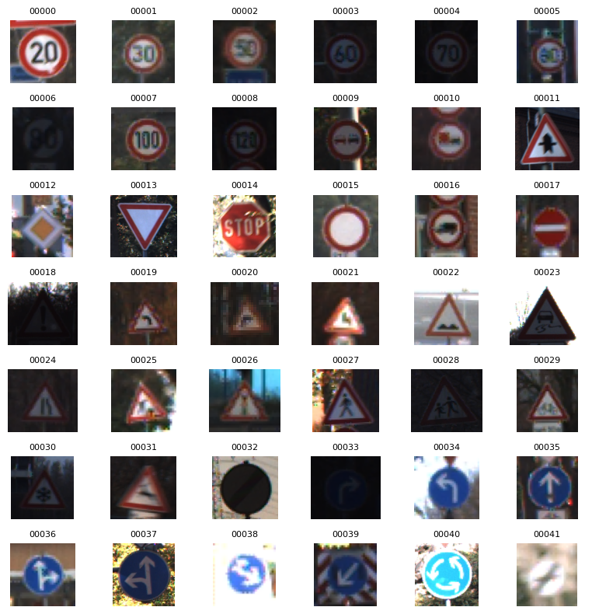
Dataset
German Traffic Sign Recognition Benchmark (GTSRB) Dataset.
43 classes
Composed of speed limits, prohibitory signs, warning signs, mandatory signs, priority signs, etc

Slide 4
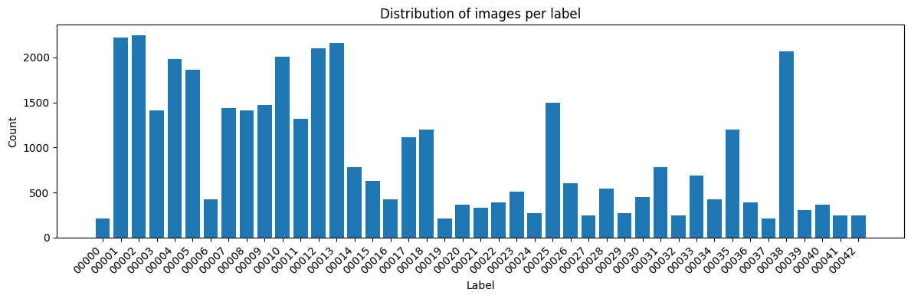
Dataset
Ranges from around 200 to 2200 counts.
Average is around 900

Slide 5
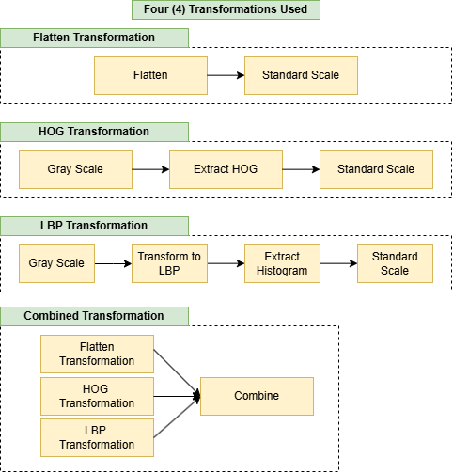
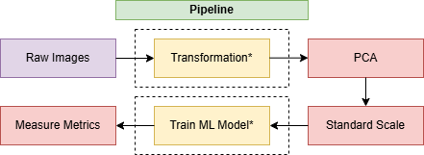
Pipeline
Those with asterisk are those that can be changed

Slide 6
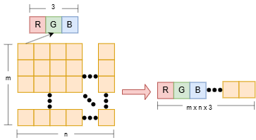
Flatten Transformation

Slide 7
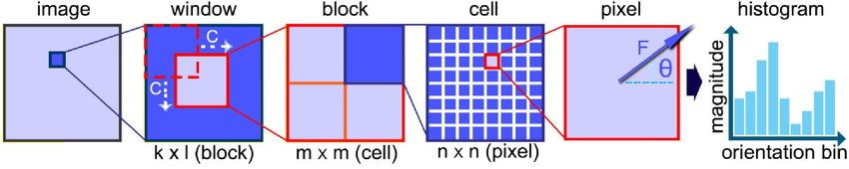
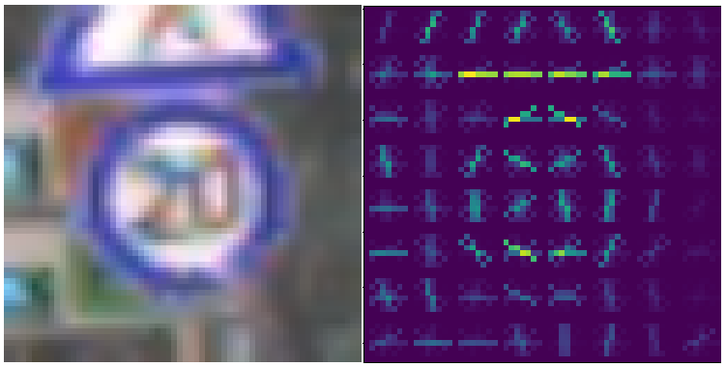
Histogram of Gradients Transformation
Figure adapted from Khan et al., “An Efficient Multi-Stage Adaptive Boosting Approach for Landmine Detection in Ground Penetrating Radar Data,” 2019.

Slide 8
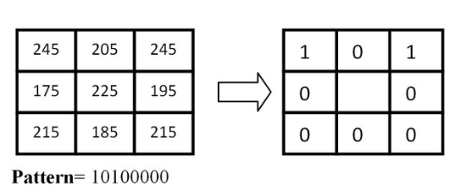
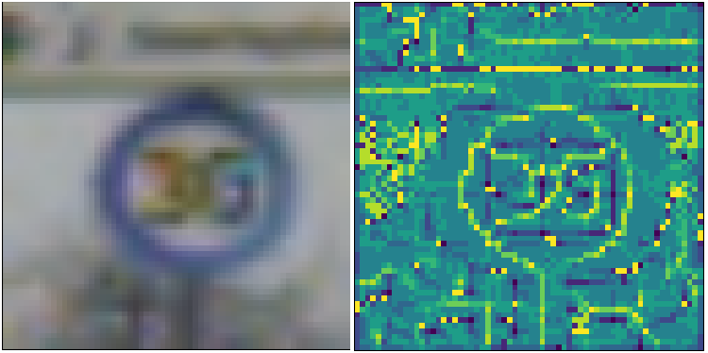
Local Binary Pattern Transformation
Figure adapted from Loy and Eklundh, “Multimodal and Mirror Invariant Image Description,” 2010.

Slide 9
Combined Transformation
Combination of the Flatten, HOG, and LBP

Slide 10
Dimensionality Reduction
To speed up training and reduce chances of overfitting, Principal Component Analysis is applied with 95% Cumulative Explained Variance Ratio.

Slide 11
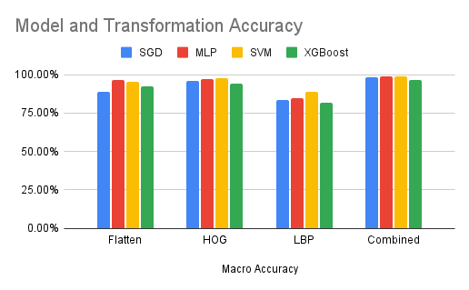
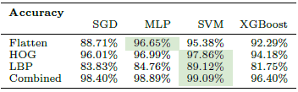
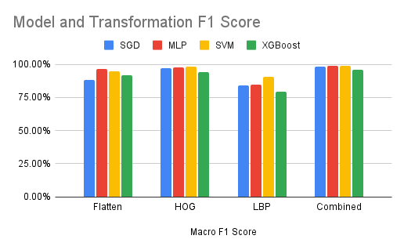
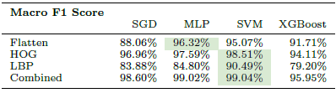
Results

Slide 12

Deep Learning Results and Human Performance

Slide 13

Confusion Matrix

Slide 14

Confusion Matrix

